Slide 1

COVID-19 – Research/Recommendations a Brief Summary by
Michael D Orcutt, PE, LEED AP
CosaTron Sales Manager
Outline
Virus Origin and Progression
A Worldwide Pandemic
Discovering Details and Recommendations
Preventative Measures
Transmission and Protection for Groups
Additional Research on Airborne Transmission
ASHRAE’s Position Document on Infectious Diseases
Mechanical System Modifications
Filtration and Disinfection Task Force
Electronic Air Cleaning Devices (EACDs)
CDC Position on Emerging Technology
CDC Summary
Increased Ventilation
Increased Filtration
Coagulation – “Growing Particulate Size” for Increased Filtration
Coagulation – “Verifying Results”

Slide 2
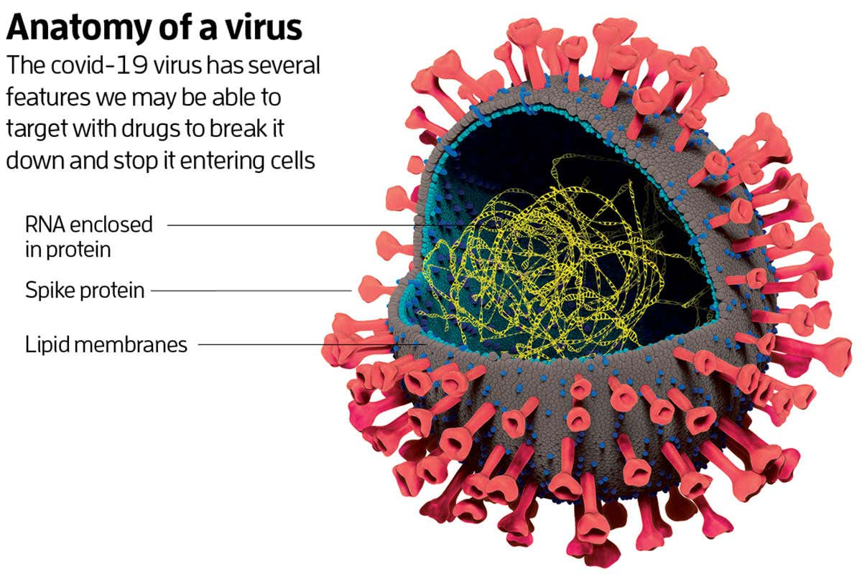
COVID-19 VIRUS – Origin and Progression
The virus was reported by the Chinese Government as having started in 17 November 2019.
The first reported case outside of China was reported to have occurred in Thailand on 14 January 2020 by the World Health Organization; WHO.
The first reported case in the United States was on 21 January 2020.
The virus has swept across the world spreading uncontrollably as can be seen on the following slide.

Slide 3
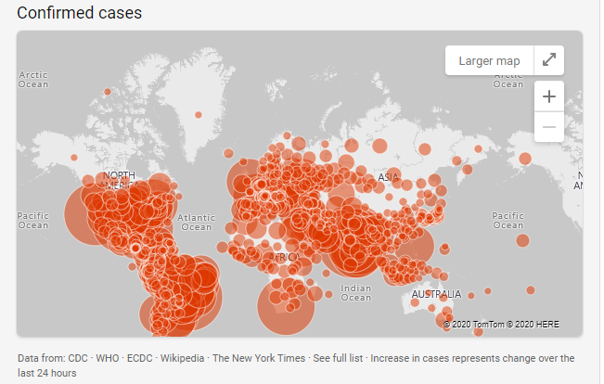
COVID-19 VIRUS – Worldwide Pandemic
Corona Virus Confirmed Cases Map
COVID-19 situation update worldwide, as of 10 September 2020
https://www.ecdc.europa.eu/en/geographical-distribution-2019-ncov-cases
Summary: Between 31 December 2019 and as of 10 September 2020, 27,891,275 cases of COVID-19 have been reported, including 903,991 deaths.
The Virus continues to spread, and the data is updated daily.

Slide 4
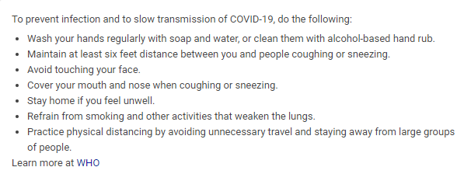
COVID-19 – Discovering Details and Recommendations
According to the Scripps Research Institute the virus found in Europe and the US as of June 2020 is 10 times more infectious than the original virus that first appeared in China.
Multiple Organizations; ASHRAE, CDC, WHO, etc. have worked together to advise the general population on how to prevent and slow the spread of the virus.
The initial recommendations were based on the predominant belief the virus was not air borne.
Later research proved that it was air borne and additional measures were required.

Slide 5
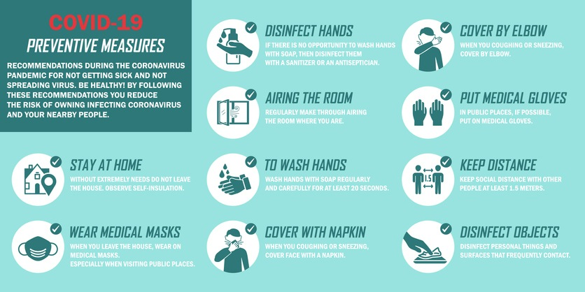
COVID-19 – Preventative Measures
The initial preventative measures addressed what an individual could do to protect themselves and their families.
They did not address what should be done by the building owners for the spaces in which we work, go to school, attend service, etc.
The focus quickly shifted when everyone realized staying at home would not be the long-term answer.
People needed to be safe in the environments in which they live.

Slide 6
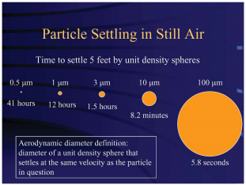
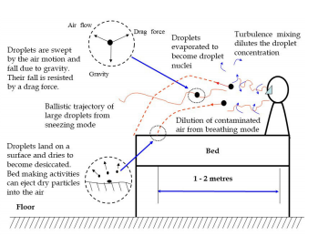
COVID-19 – Transmission and Protection for Groups
WHO acknowledged the Covid-19 Virus could be spread by airborne particles on 8 July 2020. “Focus on Droplet Transmission” https://www.bbc.com/news/world-53329946
Before July, studies had suggested the virus could persist in an aerosol form. https://www.scientificamerican.com/article/how..
ASHRAE published the ASHRAE Position Document on Infectious Aerosols in which they gave recommendations regarding aerosol transmission defining settling times in still air and projections from an occupant in a bed.

Slide 7
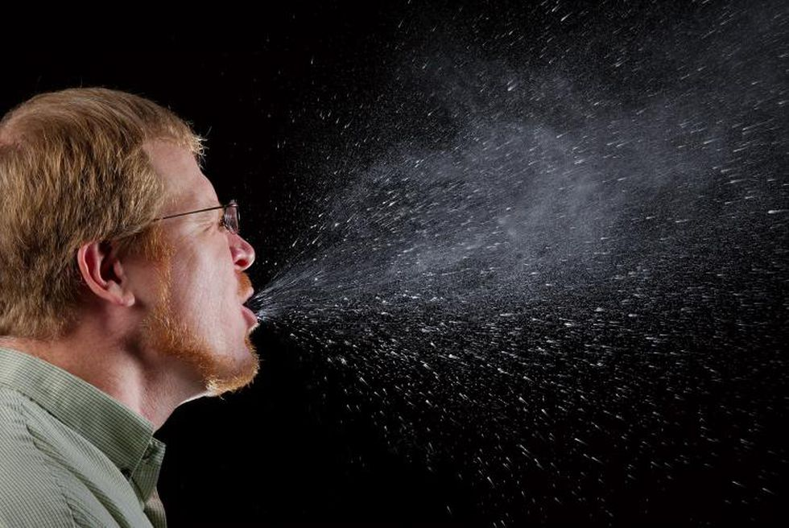
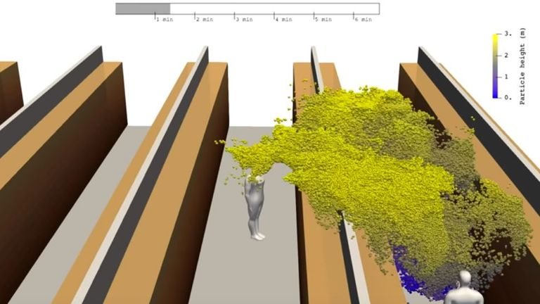
COVID-19 – Additional Research on Airborne Transmission
Focusing on one of the primary mechanisms for the spread of the virus, multiple models were developed to show probable outcomes.
Airborne transmission was found to be much further than originally surmised.
The virus moved throughout spaces by means of the controlled air stream and aerosol movement.
Apr. 09, 2020 - 0:47 - Study from Aalto University, the Finnish Meteorological Institute, Technical and Innovation Center VTT and Helsinki University release results on study on coronavirus and air-borne particles.
The Aaltohttps://video.foxnews.com/v/6148387823001

Slide 8
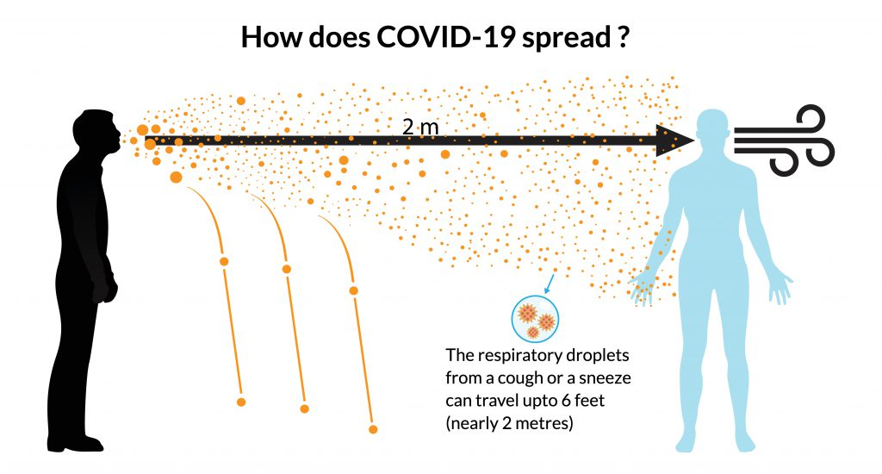
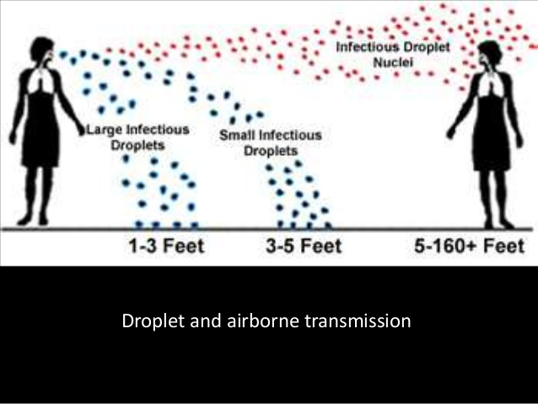
COVID-19 – Additional Research on Airborne Transmission
Initial concern was related to the transmission of the virus in larger droplet sizes that had a predicted range of 6 feet; which became the basis of social distancing.
Additional research surmised that the infectious droplet nuclei could travel much further. (5 – 160+ Feet)
Wearing of masks helps reduce the spread of the virus however, more is needed to be done to remove the virus from the spaces in which we work, go to school, attend service, etc.
The ASHRAE’s Position Document on Infectious Aerosols made recommendations on Ventilation and Air-Cleaning Strategies which could decrease the spread of the virus.

Slide 9
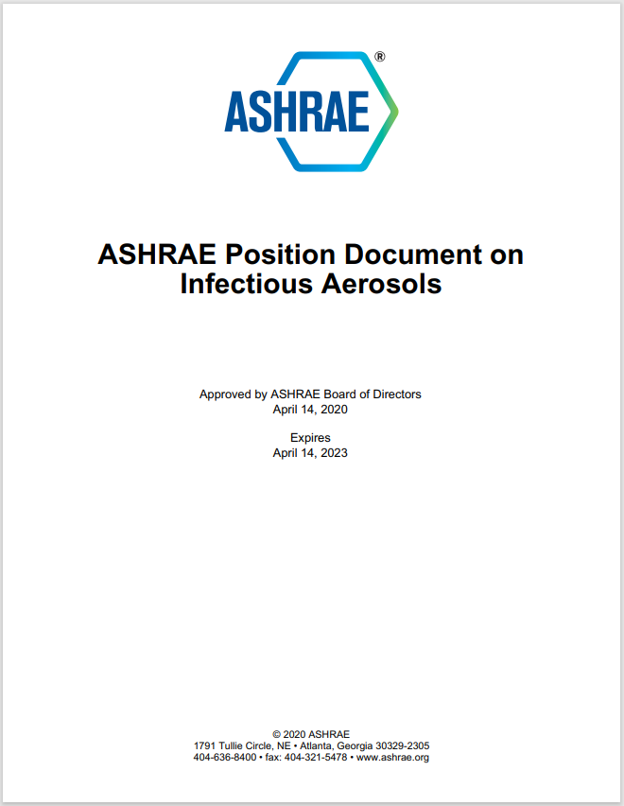
COVID-19 – ASHRAE’s Position Document on Infectious Aerosols
On 14 April 2020 ASHRAE published the Position Document on Infectious Aerosols
The intent of the paper was to inform and recommend strategies to HVAC Professionals as ASHRAE understood they “play an important role in protecting building occupants by interrupting the indoor dissemination of infectious aerosols with HVAC and LEV systems.”
Section 3.2 Ventilation and Air-Cleaning Strategies addresses ASHRAE’s recommendations. System designs and equipment could be used to interrupt the transmission routes of the virus.

Slide 10
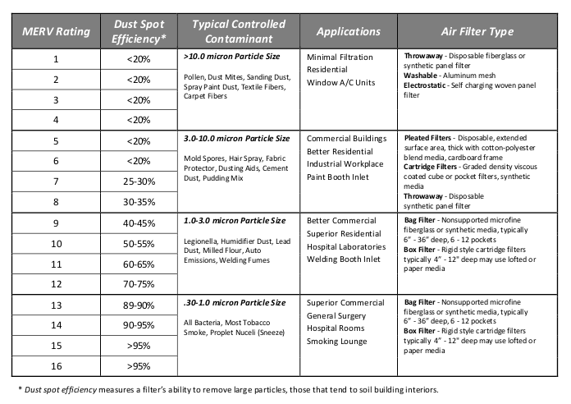
COVID-19 – Mechanical System Modifications
In order to address the recommended prevention methods by ASHRAE, many existing systems need to be modified.
Some of the recommendations in the Position Document included:
Increased Ventilation with Effective Airflow Patterns
Increased Filtration; Using a higher MERV Rated Filters.
The use of UVGI Lamps
Personal Ventilation Devices

Slide 11
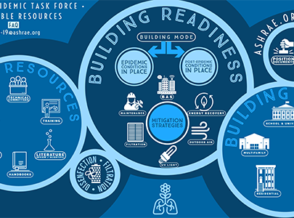
COVID-19 – Filtration – Disinfection a Task Force
https://www.ashrae.org/technical-resources/filtration-disinfection
ASHRAE has created an Epidemic Task Force to assist with recommendations with regards to the COVID-19 Virus
ASHRAE has created a web page that will be updated as new information becomes available regarding their position on filtration and disinfection. The page contains information related to the following categories.
The Task Force focused on many areas including Transmission, Safety, Maintenance, Filtration, Electronic Air Cleaning Devices and More.

Slide 12
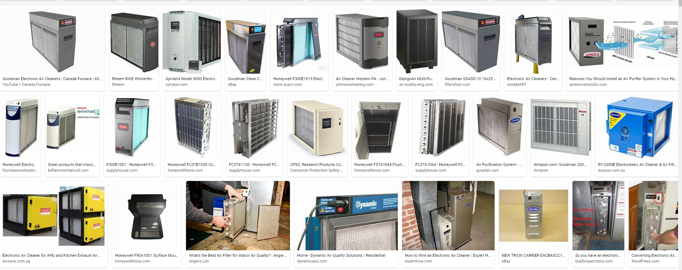
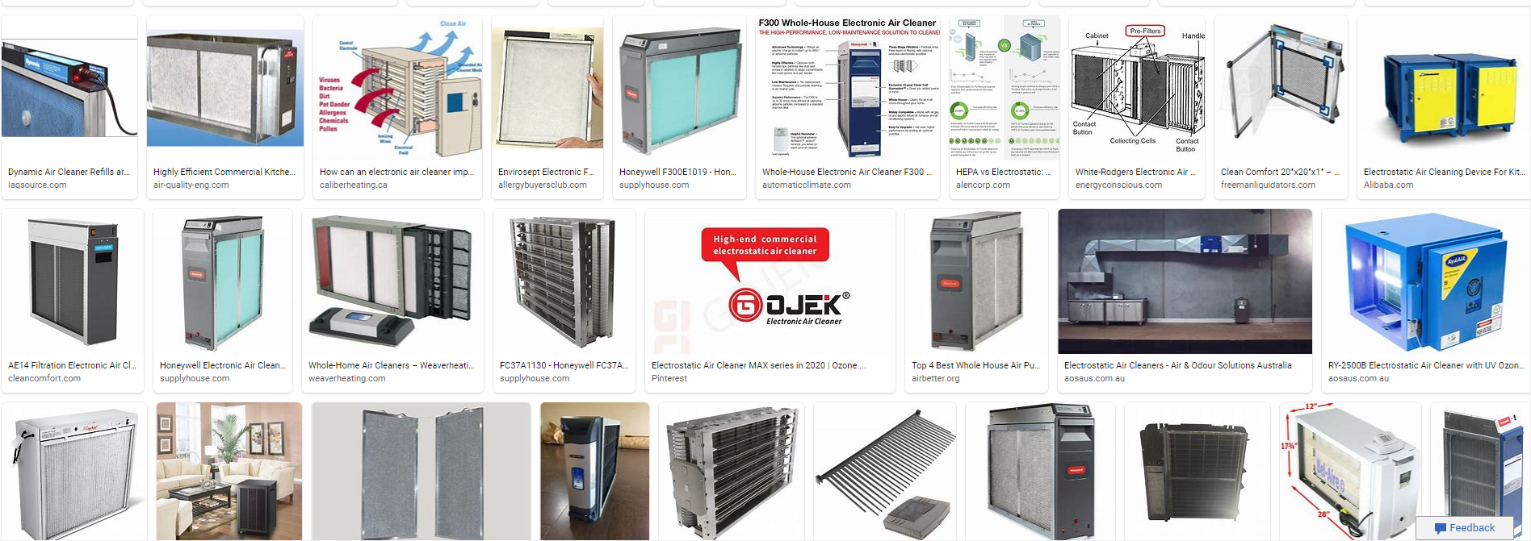
COVID-19 – Filtration – Disinfection - Electronic Air Cleaning Devices (EACDs)
The ASHRAE Position Document on Infectious Diseases did not mention Electronic Air Cleaning Devices (EACDs) other than UVGI Lamps.
Other EACDs that are in the 2015 ASHRAE Position Document on Filtration and Air Cleaning that are commonly marketed to clean the air were not mentioned.
Electrostatic Precipitators
Ionizers – tube, needle point, bipolar
Ozone Generators
Dynamic Air Filters
Photocatalytic Oxidators (PCOs)
Internet Search Images for Electronic Air Cleaning Devices shows a myriad of available products.

Slide 13
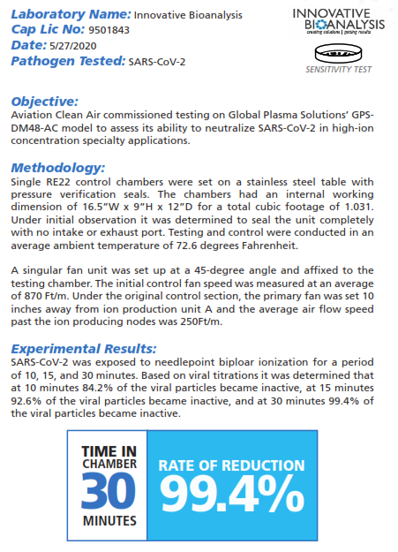
COVID-19 – Filtration – Disinfection - Electronic Air Cleaning Devices (EACDs)
Several Bipolar Ionization manufacturers tested their products with the SARS-C0V-2 virus. The published results from Global Plasma Solutions(GPS) are to the right.
Bipolar Ionization is a means of air quality control in your HVAC system that does not rely on particles making their way back to a centralized air handling unit. It works by generating positively and negatively charged ions inside the airstream and dispersing them into a space. These ions then interact with virus particles, dust, pollen and other VOCs (volatile organic compounds), allowing a filter or mask to entrap them more easily. Bipolar ionization enhances the filter or mask’s effectiveness, but does not rely entirely on them to be effective. Older versions of this technology were known for ozone production, but new “needlepoint” ionization technologies have surfaced that claim to have zero ozone production. ASHRAE’s position paper on the topic refers to these needlepoint ionizers requiring more research, and McKenney’s agrees. Bipolar Ionization: Sometimes the Best Defense is a Good Offense Published by: Ryan Yarborough | June 11th, 2020

Slide 14


COVID-19 – Filtration – Disinfection CDC Position Emerging Technology
As additional research was presented, ASHRAE updated their information regarding their task force findings. Some information was specific regarding advertised test results.
ASHRAE does not currently have a Society position on bipolar ionization. However, the ASHRAE ETF did reach out to CDC for their position on the technology.
CDC’s Position made several points:
The equipment used should meet the UL2998 standard certification (Environmental Claim Validation Procedure (ECVP) for Zero Ozone Emissions from Air Cleaners) which is intended to validate that no harmful levels of ozone are produced.
This is not to imply that the technology doesn’t work as advertised, only that in the absence of an established body of evidence reflecting proven efficacy under as-used conditions, the technology is still considered by many to be an “emerging technology”.
“Preferably, the documented performance data under as-used conditions should be available from multiple sources, some of which should be independent, third party sources.” https://www.ashrae.org/technical-resources/filtration-disinfection

Slide 15
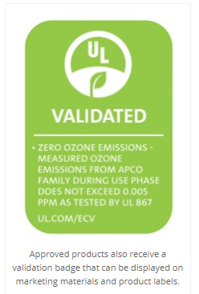
COVID-19 – Filtration – Disinfection CDC Summary
The CDCs Position highlighted several points. They were not doubting the test results of the technology used, only the fact that the testing did not consist of multiple third-party independent studies from in environment studies.
The CDC stated that the equipment used should meet the UL2998 standard certification (Environmental Claim Validation Procedure (ECVP) for Zero Ozone Emissions from Air Cleaners) which is intended to validate that no harmful levels of ozone are produced.
www.spot.ul.com lists the equipment that has passed the current UL2998 Standard at 0.005 ppm.
The CDC should affirm that any technology being used in the occupied space should meet the (ECVP).
ASHRAE stated in the Position Document on Infectious Aerosols that while UVGI is well researched and validated, many new technologies are not (ASHRAE 2018).

Slide 16
COVID-19 – Filtration – Disinfection
Increased Ventilation
ASHRAE has made recommendations regarding what could be done to prevent the spread of infectious diseases.
Whereas ASHRAE has made some recommendations regarding the use of EACDs it has limited them to devices specifically tested over an extended period of time; UVGI.
ASHRAE has not discounted the possibility that other EACDs may work.
ASHRAE recommended Increased Ventilation with Effective Airflow Patterns, Increased Filtration and Personal Ventilation Devices.
Increased Ventilation works on the premise that “contaminants” will be removed from the space and replaced with cleaner air . The premise is sound with association to the larger particles that move readily via the controlled airstream. It is questionable with regards to the particles that are submicron and do not.
The Particle Settling Time in Still Air is a good reference. The smaller particles take much longer to settle in still air as they have very little surface area and mass.
The Droplet and Airborne Transmission graphic shows that the Infectious Droplet Nuclei may travel in excess of 160 feet. This would infer that controlled air stream has less impact on removal of the particles.

Slide 17
COVID-19 – Filtration – Disinfection Increased Filtration
Increased Filtration was recommended under the assumption that the higher MERV rated filters would remove more contaminants from the space.
The MERV Ratings as shown on the Chart to the right reference filter ability percentages from 0.3 micron – 1.0 micron with regards to MERV Ratings of 13-16.
The standard mechanical system is designed using MERV8 filters which are capable of filtering out 3.0 micron sized particulate/contaminants and larger.
The COVID-19 Virus has been stated to be 0.12 microns in size; source Mayo Clinic.
Submicron particles move in the air by means of electrical fields. They have very little mass for gravitational pull and very little surface area for induction into the controlled air stream.
In order for increased filtration to work, the mechanical system must have the ability to remove the particles that are not entrained into the controlled airstream; those less than 3.0 microns.
Coagulation/Conglomeration is a means by which the particles collide, stick together and grow in size.

Slide 18
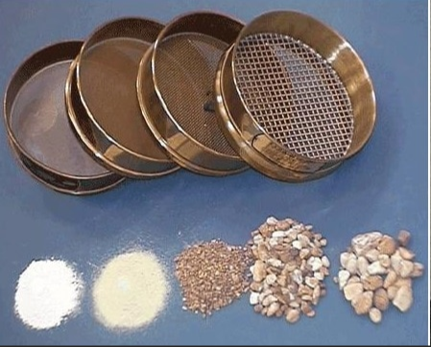
COVID-19 – Filtration – Disinfection Coagulation “Growing Particulate Size”
Coagulation describes the process by which particles that are suspended in a fluid come into contact and coalesce or adhere to one another. Particles interact because of Brownian (thermal) motion, hydrodynamics, and/or gravitational, Van der Waals, Coulomb, or other forces. Source Monte Carlo Simulation of Coagulating Aerosols by Jose Ignacio Huertas
If submicron particles can be grown to a size by which they become air entrained, they can be removed by the controlled airstream and captured by the filters.
Once the particles/contaminants are removed at the filters, the filters can be removed from the system and treated as hazardous materials or the filters can be treated by a means to kill any biological.
Several EACD manufacturers market their products to “agglomerate” particles allowing them to grow in size. Whether it is the attraction of charged particles to oppositely charged particles or the implementation of High Voltage and High Frequency fields to accelerate the natural collision rates; increasing the particle size is the key to allowing filters to remove them from the space.
Verification of results can be performed using particle counters and air quality monitors. In accordance with the CDC recommendations, testing in the space in which the technology is used is recommended for verification.
The image is used as a synonym of varying filter ratings.

Slide 19

COVID-19 – Filtration – Disinfection Coagulation “Verifying Results”
The most important issue with any recommendation is verification of results.
The most empirical measurement is the reduction of contaminants in the air that is being cleaned.
Test results that are not from as used environments do not meet the CDC recommendation for testing.
Using a particle counter or air quality monitor in as used spaces can provide real-time results.
As the COVID-19 Virus will likely not be the last virus of concern, it is important that a system/standard be developed that measures the indoor air quality in the occupied space.
The system/standard can be used to ensure the building occupants are protected to the best ability of the Building Owners, Design Engineers and Maintenance Department using the best available.
If we learn from the COVID-19 Virus today, we will be better suited to protect all tomorrow.

Slide 20
COVID-19 – Research/Recommendations a Brief Summary by
Michael D Orcutt, PE, LEED AP
CosaTron Sales Manager
Thank you for Your Time
Please note that many of the images in this presentation were taken from internet research and were referenced as noted. This presentation was developed in order to provide a summary of the COVID-19 Virus and topics surrounding slowing or preventing its spread. Many people have worked together to this end and this presentation is an expression of their efforts.

